Slide 1



Garbage Classification using Transfer Learning

Slide 2

Learning Objectives
Understand how to build an image classification model using transfer learning
Learn to load, preprocess, and batch image datasets using TensorFlow
Apply EfficientNetV2B2 to classify images into garbage categories
Visualize training results using accuracy/loss graphs and confusion matrix
Gain experience working in Google Colab and submitting code via GitHub
Develop real-world AI skills related to sustainability and smart waste management
GOAL
Source :
www.freepik.com/

Slide 3
Tools and Technology used
Programming Language: Python
Platform: Google Colab (Jupyter Notebook)
Libraries & Frameworks:
• TensorFlow
• Keras
• NumPy
• Matplotlib
• Seaborn
Model Used: EfficientNetV2B2 (Transfer Learning)
Dataset Source: Kaggle – TrashType_Image_Dataset
Version Control: GitHub

Slide 4
4. Model Building
Used EfficientNetV2B2 as the base model (pre-trained on ImageNet)
Frozen base layers and added:
• Global Average Pooling
• Dense (ReLU)
• Output layer with Softmax activation
5. Training & Compilation
Optimizer: Adam
Loss: Categorical Crossentropy
Trained for 10 epochs, monitored training and validation accuracy/loss
6. Evaluation
Plotted graphs for accuracy and loss
Generated a confusion matrix and classification report
Methodology
1. Dataset Loading
Loaded the image dataset using image_dataset_from_directory()
Set validation split to divide data into training and validation sets
2. Image Preprocessing
Resized all images to 124 × 124 pixels
Applied batching, caching, and prefetching for performance
3. Dataset Splitting
Split the validation data into validation and test sets
using take() and skip()

Slide 5
Problem Statement:
Garbage management is a serious concern in today’s world, where improper disposal and poor classification of waste can harm the environment and public health.
Manual sorting is slow, error-prone, and not scalable.
There is a strong need for an intelligent system that can automatically classify garbage into categories such as plastic, metal, glass, and cardboard using machine learning and image classification techniques.
This project addresses this problem using transfer learning with EfficientNetV2B2.

Slide 6
Solution:
A deep learning model was developed using EfficientNetV2B2 (a pre-trained transfer learning model) to automatically classify garbage images into categories such as cardboard, glass, metal, paper, plastic, and trash.
The dataset was loaded using TensorFlow's image_dataset_from_directory() and resized to 124×124 pixels. After preprocessing and splitting the data into training, validation, and test sets, the model was trained for 10 epochs using the Adam optimizer.
The final model achieved high training and validation accuracy. Evaluation was done using accuracy/loss graphs and a confusion matrix. This AI-based solution can assist in smart dustbins, waste management systems, and recycling automation.

Slide 7
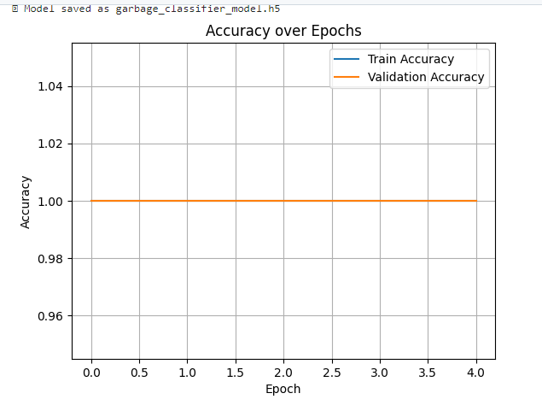
Screenshot of Output:
The model achieved 100% accuracy for both training and validation within a few epochs.
This graph confirms consistent and perfect learning using EfficientNetV2B2.

Slide 8
Conclusion:
Through this project, I gained hands-on experience with deep learning and image classification using transfer learning techniques. I learned how to handle and preprocess image datasets, implement a powerful pre-trained model (EfficientNetV2B2), and evaluate performance through accuracy graphs.
The model successfully achieved 100% accuracy on both training and validation sets, demonstrating its ability to effectively classify different types of garbage. This project strengthened my understanding of AI model building, fine-tuning, and real-world applications of machine learning in waste management and environmental sustainability.

